Slide 1
ENGI 301 PlotBot Proposal
February 19, 2024
Andrew Bare

Slide 2
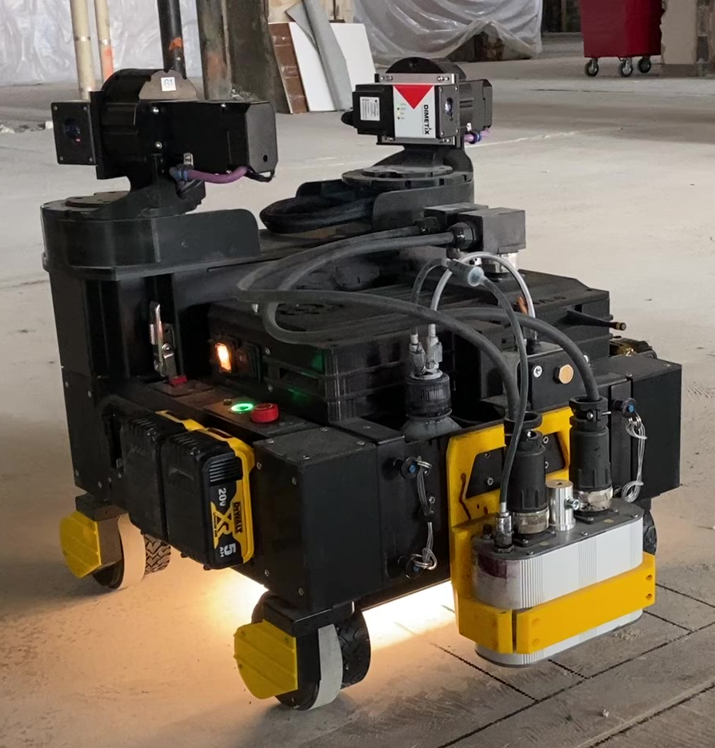
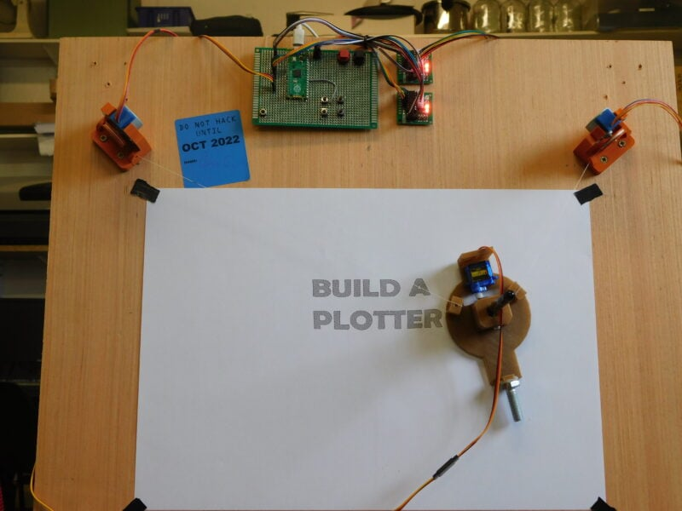
Background Information
Fig 1. Rugged Robotics prototype
PlotBot: small robot that can draw large pictures on the ground/on a sheet of paper with a marker from gcode.
Inspired by Rugged Robotics’ layout robots (fig. 1) & Doug Hebda’s PocketBeagle CNC project.
Numerous larger robots exist that do this, but I am unable to find an example online at this scale.
Unlike a pen plotter (fig. 2) the size of the paper is functionally unlimited with a free-moving robot.
This prototype will use a gcode file manually loaded on to the PocketBeagle. Future iterations could utilize a screen and/or a web Bluetooth/WiFi interface to select or upload files. I don’t want to deal with networking for this project unless I have extra time.
The robot will have two wheels and a ball bearing caster to simplify movement.
The system design will feature two stepper motors to control the wheels, an estop button, a servo to retract/unretract the pen, a running LED, a limit switch to stop execution on collision & a buzzer to indicate complete execution.
Fig 2. Pen plotter
https://www.raspberrypi.com/news/make-a-raspberry-pi-pico-pen-plotter/

Slide 3
System Block Diagram
PocketBeagle
P1.29
P1.31
P1.33
P1.35
P2.02
P2.04
P2.06
P2.08
P2.01
(PWM1)
P2.10
P2.18
P2.20
P2.20
AIN2
AIN1
BIN1
BIN2
AIN2
AIN1
BIN1
BIN2
Adafruit TB6612
motor driver breakout
Adafruit TB6612
motor driver breakout
E-Stop
Button
2kHz Buzzer
Front Limit Switch
Running Light
Red, yellow
green, grey
Red, yellow
green, grey
NEMA 17 Stepper
(Left)
NEMA 17
Stepper
(Right)
Orange
Retraction
Servo

Slide 4
Power Block Diagram
12V
5V
Stepper
Create a Power Block Diagram
Label voltages / currents of components
Running Light
PocketBeagle
5V @ 2A
12V to 5V DC-DC Converter
Buzzer
12V Battery
Retract Servo
Adafruit TB6612
12V @ 1.2A
NEMA 17 Stepper Motor
Adafruit TB6612
12V @ 1.2A
NEMA 17 Stepper Motor

Slide 5
Components / Budget
Component | ENGI301 to Buy? | Cost
2x Adafruit TB6612 Stepper Motor Driver* https://www.adafruit.com/product/2448 | Yes | $6.95 per
NEMA 17 stepper motor (Find in OEDK) | No | N/A
12V – 5V DC-DC Converter https://www.amazon.com/HiLetgo-DC-DC-Module-Vehicle-Charger/dp/B01D0WSBDC | Yes | $8.89
Adafruit 2kHz buzzer https://www.adafruit.com/product/1536 | Yes | $0.95
12V LiPo battery (Find in OEDK) | No | N/A
LED (Find in OEDK) | No | N/A
Mini servo (Find in OEDK) | No | N/A
Laser-cut acrylic and assorted hardware (Find in OEDK) | No | N/A
Total paid by ENGI 301 |  | $16.79
* Not pre-approved

